Slide 1
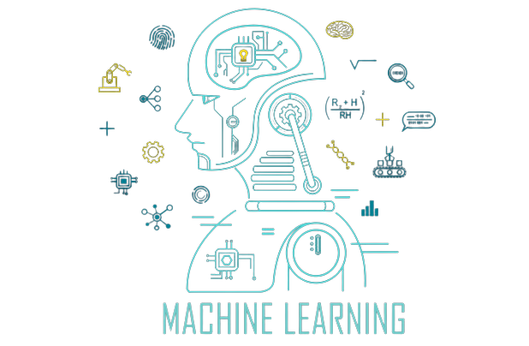



The Power of Machine Learning (ML) in Game Technologies
Fuat Yiğit Koçyiğit
CMPE316

Slide 2
TABLE OF CONTENTS
01
02
03
04
What is Machine Learning
Machine Learning in Game Development
Challenges and Limitations
Conclusion

Slide 3

01
What is Machine Learning

Slide 4
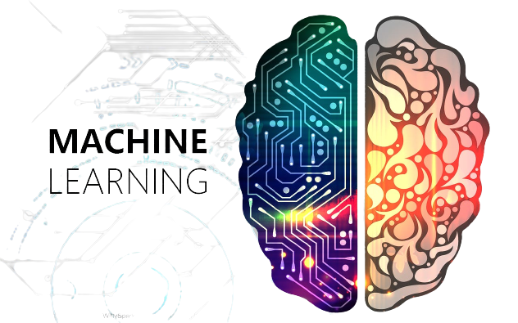
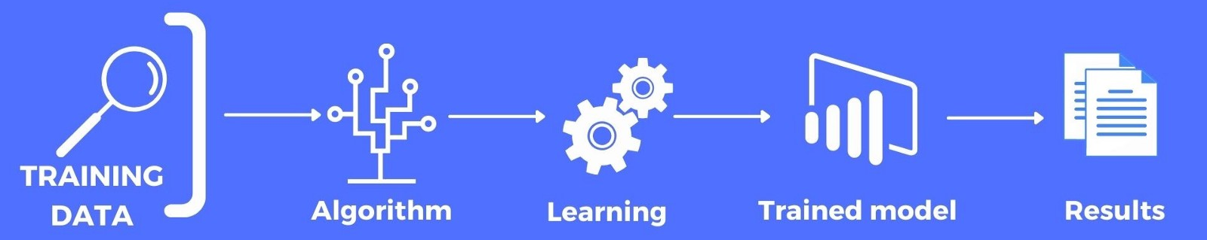
WHAT IS Machine Learning
Machine learning is a form of artificial intelligence that allows computers to learn from data without being told what to do.
Machine learning is being used in many industries, including game development, and has the potential to change the way games are designed and played.
Machine learning uses statistical techniques to identify patterns in data and learn from them.
There are three main types of machine learning: supervised, unsupervised, and semi-supervised.
Supervised learning uses labeled data to teach the algorithm, while unsupervised learning looks for patterns in unlabeled data. Semi-supervised learning uses both approaches.

Slide 5
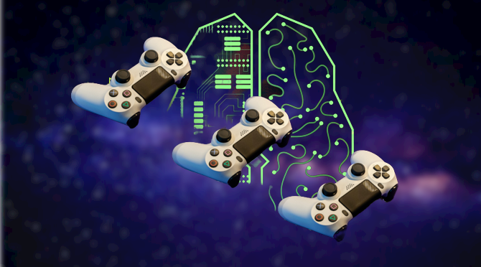
02
Machine Learning in Game Development

Slide 6


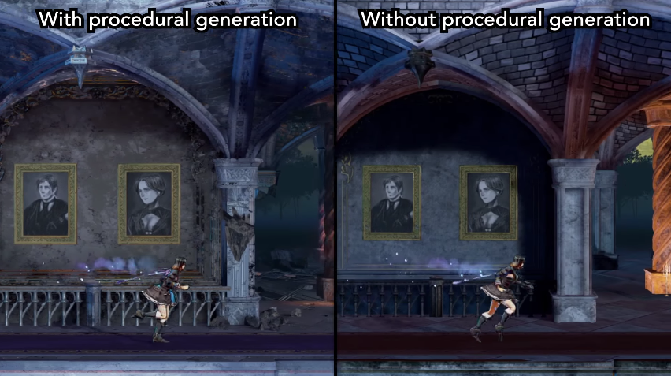
MAIN IDEAS OF ML in Game Development
NPC Behavior
Game Analytics
Procedural Content Generation
Machine learning is used in game development to create more realistic NPCs, improve game analytics, and generate procedural content.
NPCs can be trained to behave more like human players, and machine learning can adjust their behavior based on player actions.
Game analytics can help developers understand player behavior and preferences, and machine learning algorithms can identify patterns and predict player behavior.
Machine learning can be used for cheat detection and prevention, matchmaking, and player retention.
Machine learning can be used to generate more sophisticated and varied procedural content, such as game worlds, levels, and items.
Developers can train machine learning algorithms to generate content that is more aligned with player preferences by analyzing player data and feedback.

Slide 7
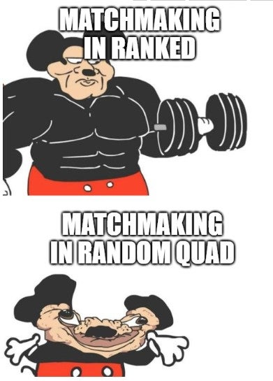


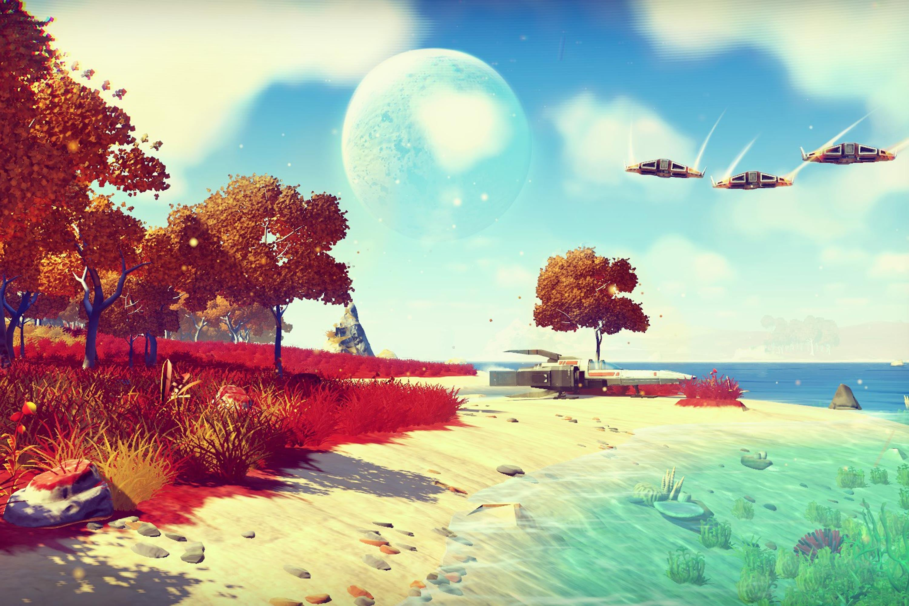
Improved Gameplay With ML
Challenging opponents
Prediction and
Personalization
Smarter NPCs
Machine Learning
Immersive gaming experience and enviornment
Analyzing Preferences

Slide 8


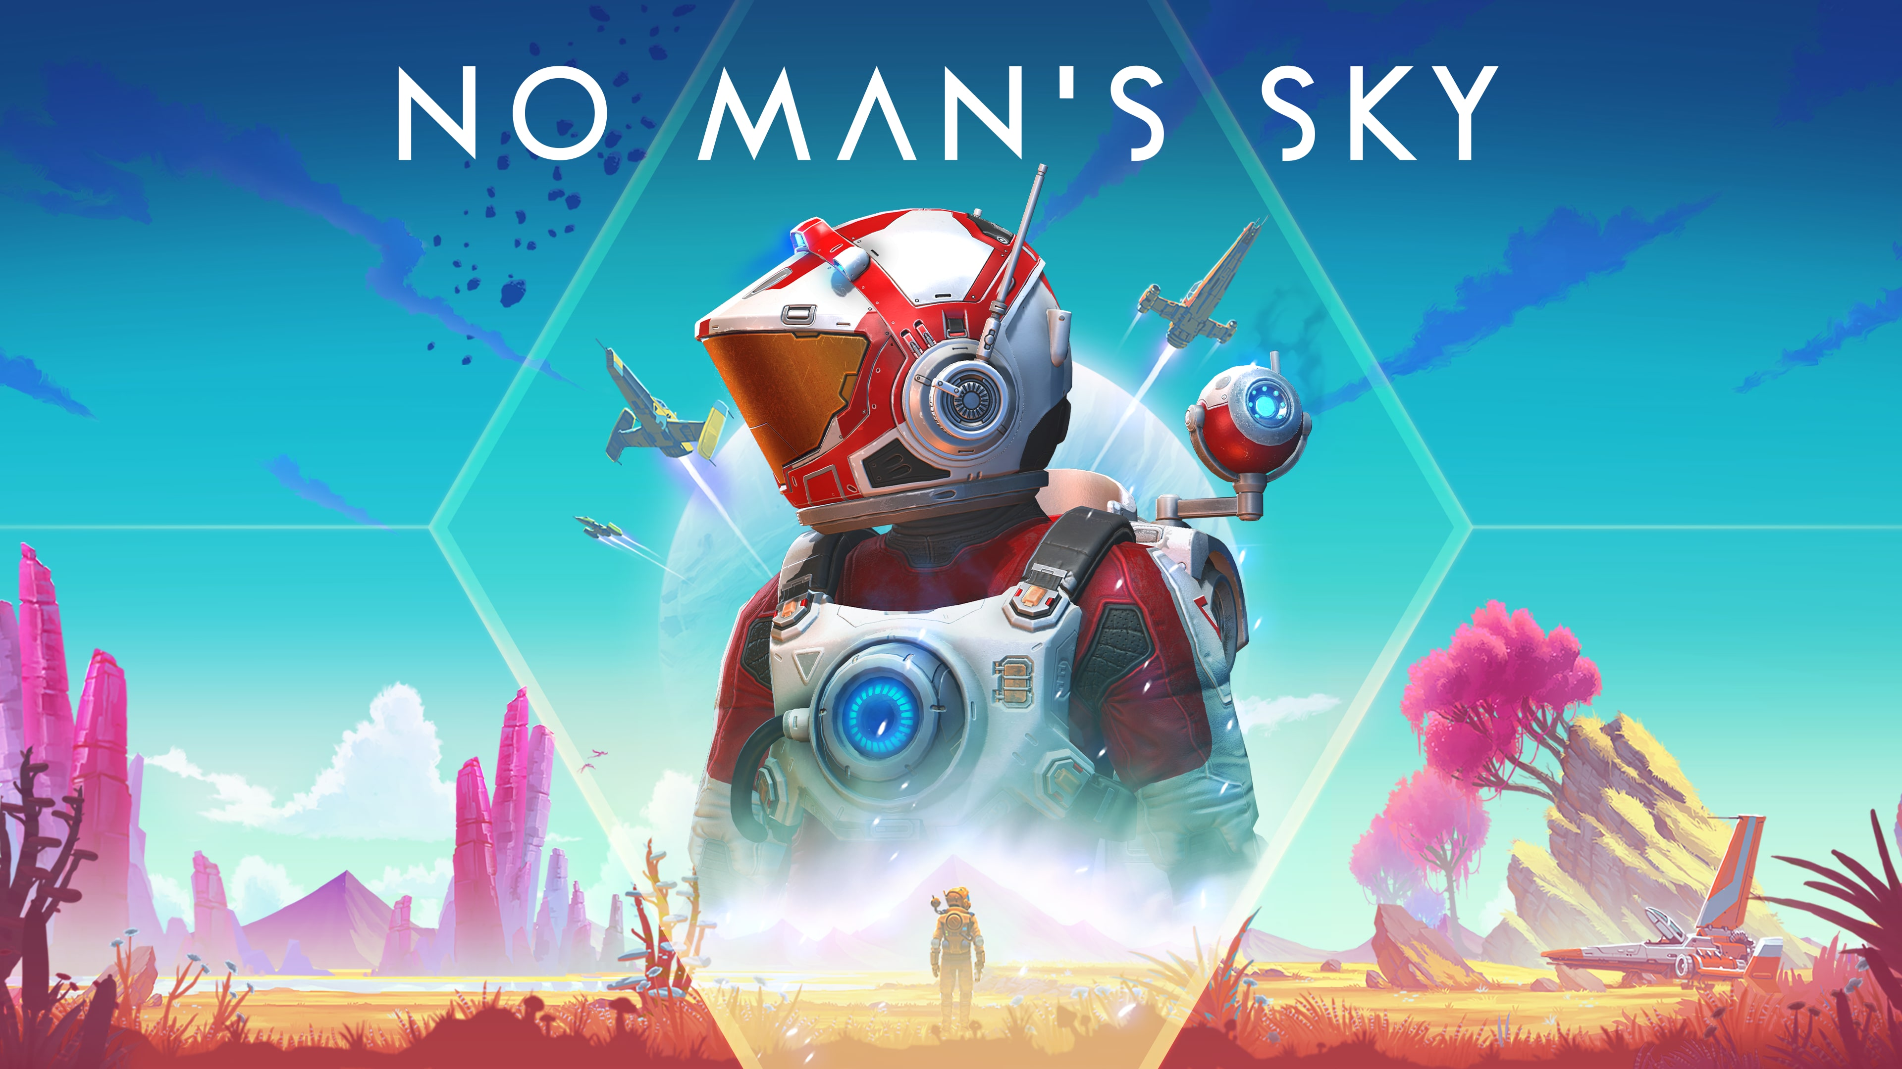
Real Life Examples

Slide 9
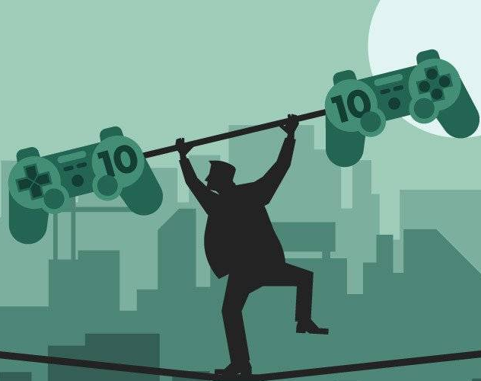
03
Challenges and Limitations

Slide 10
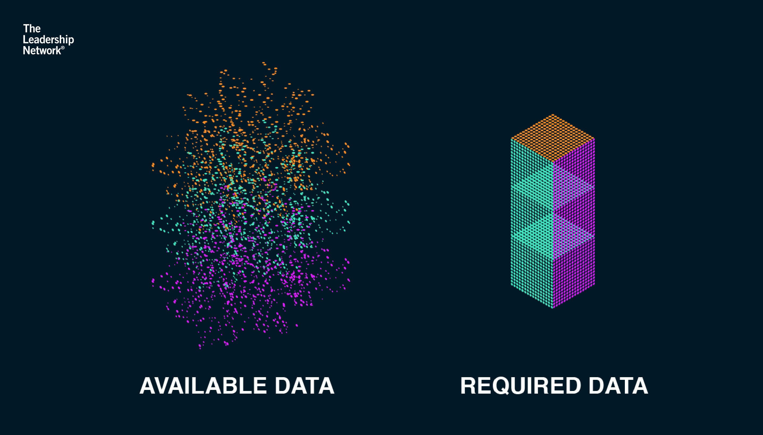

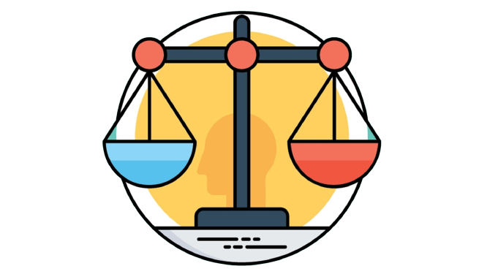

Data availability and quality
Interpretability
Machine learning algorithms require large amounts of accurate and representative data to learn from.
Machine learning models can be difficult to understand, making it hard to diagnose and fix problems.
Ethical considerations
Cost and scalability
Machine learning algorithms can perpetuate existing biases in data, leading to unfair outcomes for certain groups of players.
Implementing machine learning in games requires significant resources and expertise, and may not be feasible for smaller game studios.

Slide 11

04
Conclusion

Slide 12

Conclusion
NPCs
Data Requirements
Improves non-player character (NPC) behavior
Data availability and quality is very important
Game Analytics
Cost and Scalibility
Enhances game analytics and player retention
Has high costs and resource requests that may not be feasible for smaller game studios
Procedural Content
FUTURE
Generates procedural content for improved gameplay
We could see really innovative and exciting applications of machine learning in games in close future

Slide 13
THANKS For Listening!
I can answer if you have any questions ☺

